Slide 1
Nakuja Internship Week 1 Progress Report
FAITH CHELANGAT
&DERRICK KIRIMI

Slide 2
Tasks completed last week
Familiarise myself with the project
Soldering on the prototype
Redesigning the reaction wheel

Slide 3
Tasks to be completed in the following week
Design of the N2 reaction wheel
Logging of data onto the SD card
Research on the mounting case and safety cage of the reaction wheel

Slide 4
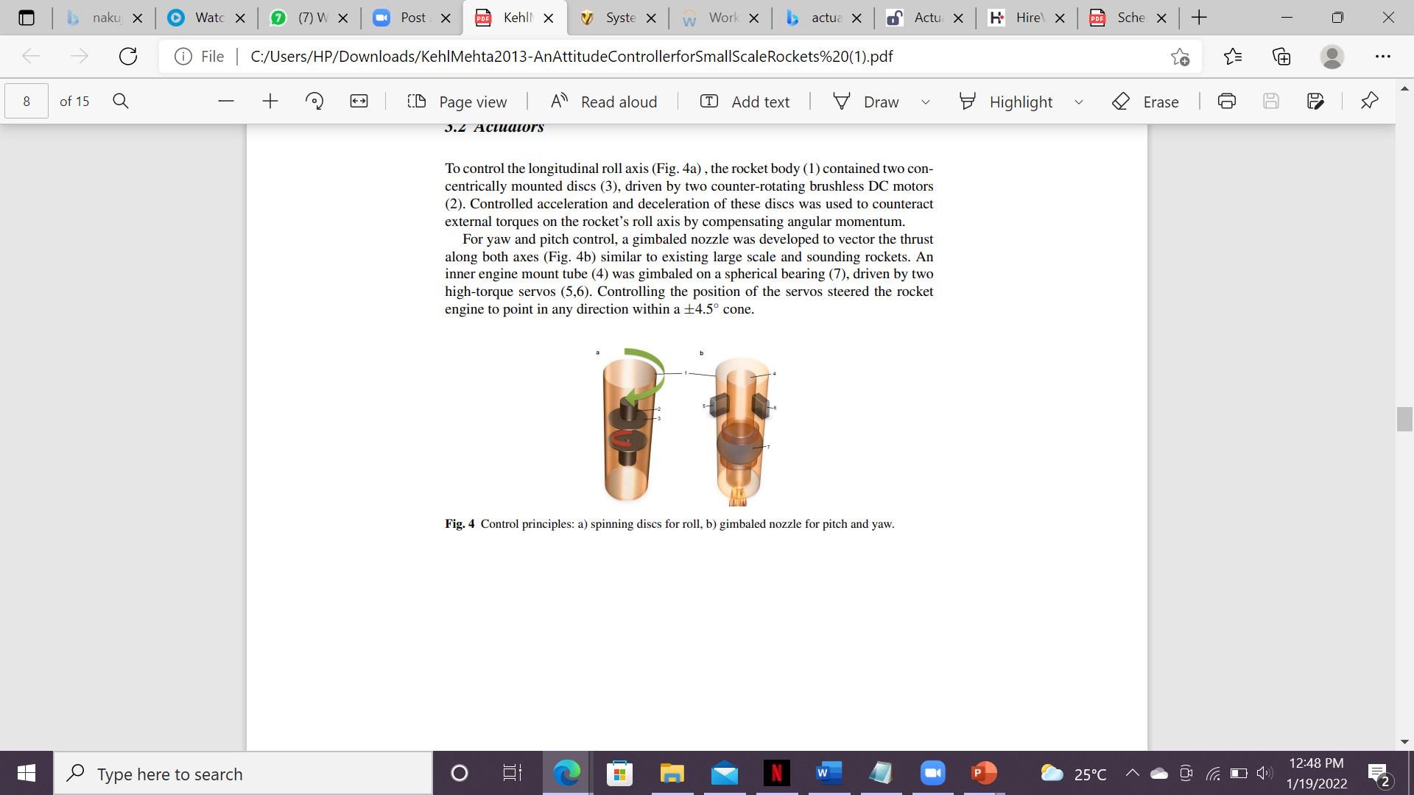
schematic

Slide 5
Timeline
Month | Week | Tasks
January | Week1 | Familiarising with the N1/N2 project Soldering of prototype flight control PCB Research on the design of reaction wheel
 | Week2 | Design of the N2 reaction wheel Logging of data onto the SD card Research on the mounting case and safety cage of the reaction wheel
 | Week3
 | Week4
February | Week1 | Design of the mounting case and safety cage of the reaction wheel
 | Week2 | Research on Kalman Filter and ways to improve it
 | Week3
 | Week4

